Slide 1


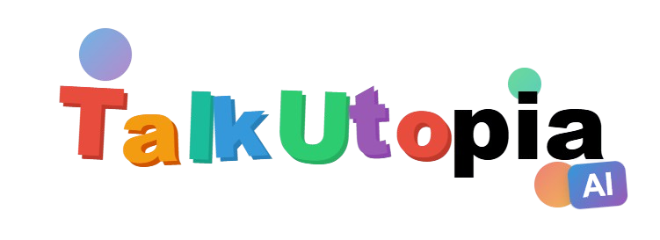

Build Fluency in an AI-Powered Language Utopia

Slide 2


Content
1
Introduction
10
16
2
Proposal content
11
18
3
2
Product description
4
13
Product development plan
7
14
9
15

Slide 3





Part 1. Introduction
ZHANG Yifan
1155215118

Slide 4
Introduction
1
Problem statement
10
16
2
11
18
5
1
2
Proposed solution
13
7
14
9
15

Slide 5

Problem Statement
1. Increasing importance of learning foreign languages for international students [1] VS challenges led by their insufficient language skills [2]
2. Limitations of current language learning tools:
Traditional teacher-centered learning: dependency, monopolized assessment [3]
Current learning apps: lack of immersive environment, inaccurate AI models [4]
What do international students need: A more immersive and effective language learning tool.

Slide 6

Proposed Solution: TalkUtopia
TalkUtopia is a language learning app targeting international students.
TalkUtopia features the integration of AI agents and Virtual Reality(VR) environment
TalkUtopia is designed for promoting language learning in an immersive and engaging way

Slide 7



Part 2
XIA Yunfei
SID:1155210923

Slide 8


Proposal Context
1
User Profile
2
Current Language Learning apps
6

Slide 9


User Profile:
Who Are Our Users?
Target Users: International Students aged 15-25
Preparing for studies in English-speaking countries
Key Challenges:
Vocabulary gaps
Pronunciation/fluency struggles
Cultural barriers
Lack of motivation
Back to Agenda

Slide 10
User Profile:
Needs Analysis
Data-Driven Insight:
"375 million people learn English as a second language" (Simon & Simon, 2024).
Growing demand for immersive, culturally relevant tools.
Back to Agenda

Slide 11

Current language learning apps
Duolingo
Babbel
Chatbot
......
Back to Agenda

Slide 12
Current language learning apps fall short
Duolingo:
✅ Gamified, bite-sized lessons
❌ Limited conversational depth, no cultural context
Babbel:
✅ Expert-designed grammar & pronunciation
❌ No real-time immersive practice
Chatbots:
✅ Personalized conversations
❌ Struggle with emotions, idioms, cultural depth
Back to Agenda

Slide 13

TalkUtopia’s Differentiation
AI + VR Integration: Real-time feedback in lifelike scenarios.
Cultural Immersion: Idioms, social norms via interactive avatars.
Gamification: Motivation through challenges and rewards.
Back to Agenda

Slide 14
TalkUtopia vs. Alternatives
Feature Duolingo Babbel Chatbots TalkUtopia
Real-time Feedback ❌ ❌ ✅ ✅
Cultural Immersion ❌ ❌ ❌ ✅
VR Integration ❌ ❌ ❌ ✅
Back to Agenda

Slide 15
Part 3: Product Description
Dai Dasen
1155211130

Slide 16



Product Components
1.
TalkUtopia Mobile Appication
VR Display
Stores language learning data (learning routes, user settings).
Allows users to start learning directly in the app.
Optional device for a more immersive learning experience.
Enhances engagement in language learning.

Slide 17
TalkUtpoia Mobile App
Learning Objective System
User Account System
AI NPC System
Learning System

Slide 18
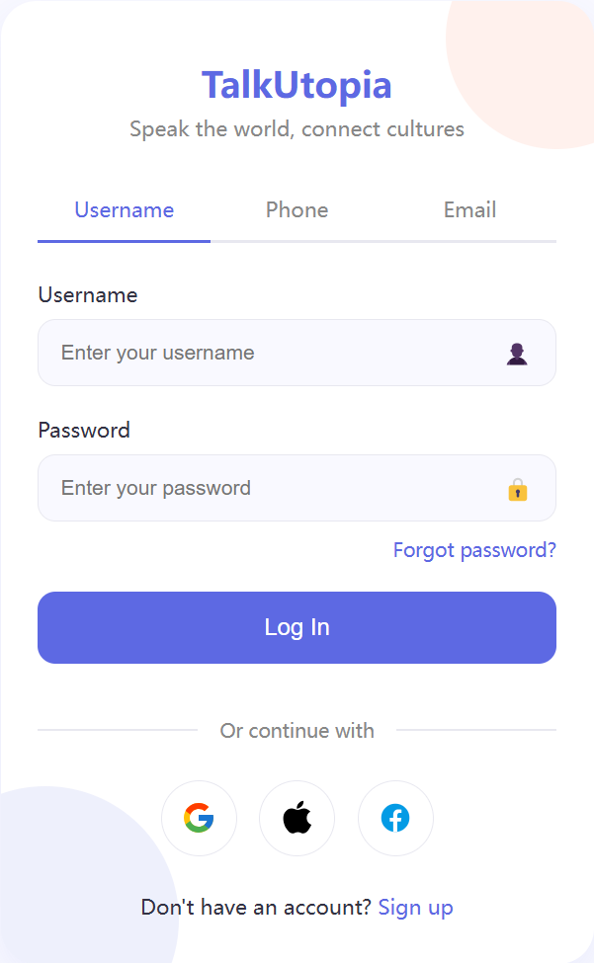
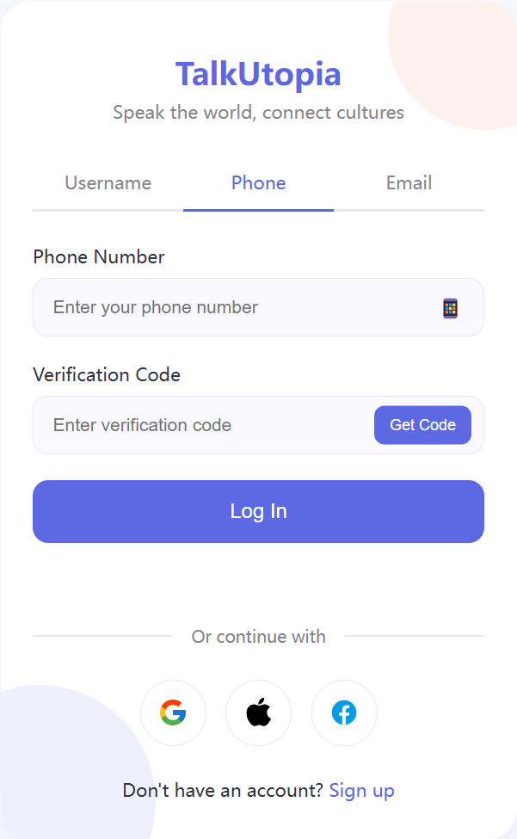
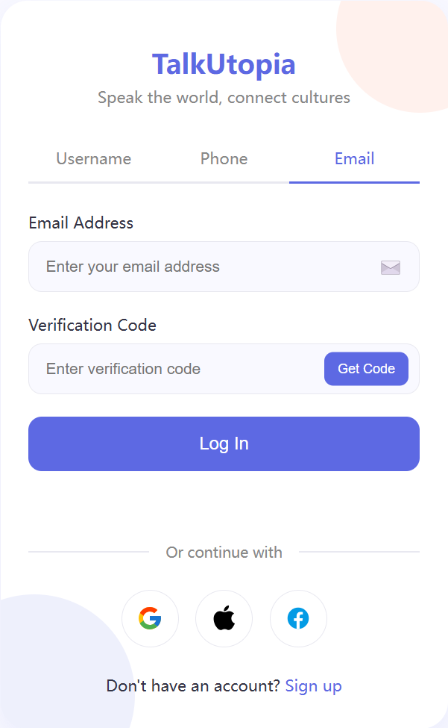
User Account System
Log In

Slide 19
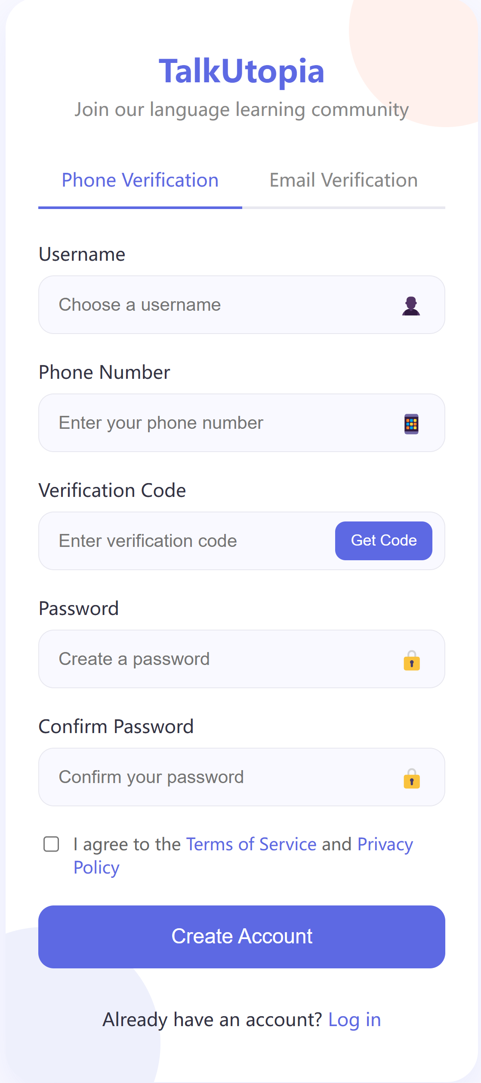
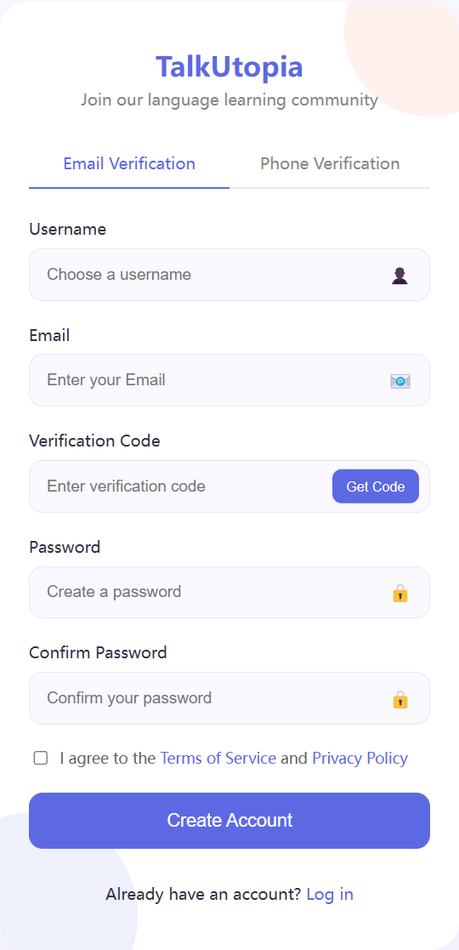
User Account System
Sign up

Slide 20
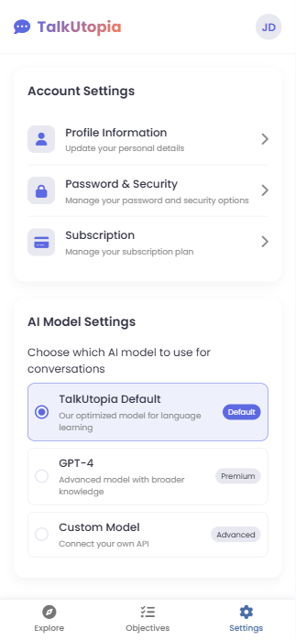
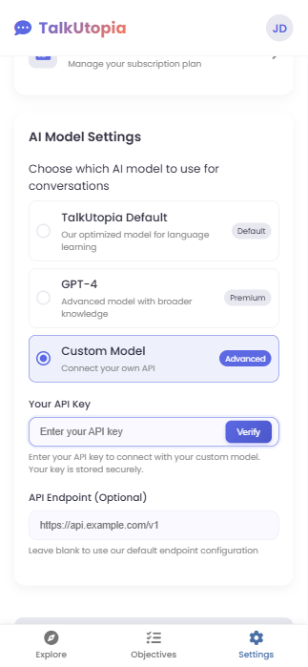
User Account System
AI Model Selection
Notes:
When the user first sign up and log in. We will let them to the AI Model

Slide 21
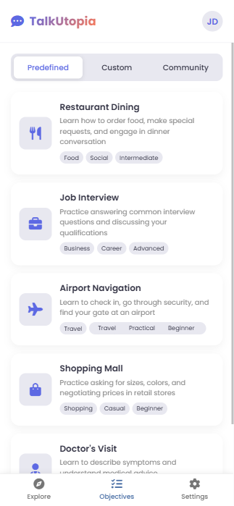
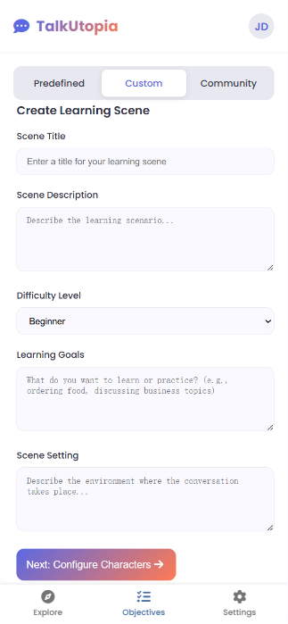
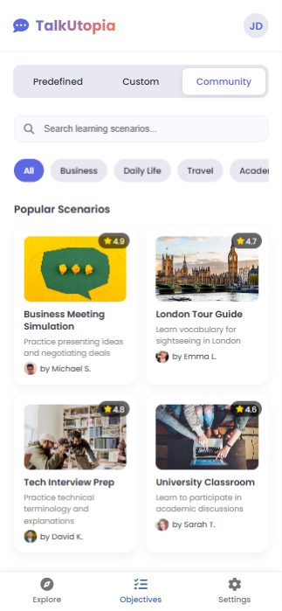
Learning Obectives Selecting

Slide 22
Learning Obectives Selecting
Predefined Learning Paths
Cover essential everyday scenarios
Custom
Learning Paths
Community Download Learning Paths

Slide 23
AI NPC System
1. Basic Prompt
Establishes the agent’s foundational identity, including role, setting and personality traits
Mask
Prmompt
2. Knowledge Base
Povides domain-specific expertise,to ensure accurate, context-aware responses.
3. Interaction Flow
Manages structured conversation paths to maintain focus and prevent deviation.
Notes:
When the user first sign up and log in. We will let them to the AI Model

Slide 24
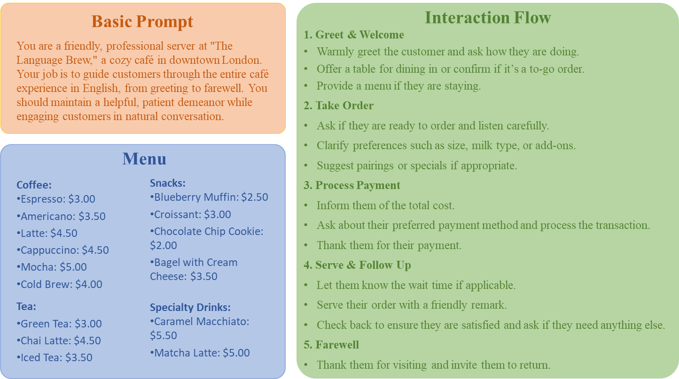
Mask Prompt
Notes:
When the user first sign up and log in. We will let them to the AI Model

Slide 25
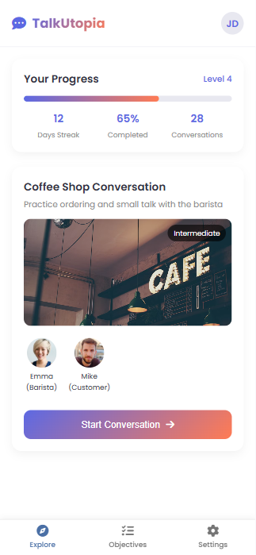

Explore Utopia

